Slide 1
Unit-IV
Wave energy

Slide 2
Wave energy
Wave machines convert ocean energy to mechanical energy.
Ocean wave energy is due to the periodic to-and-fro, up-and-down motion of water particles in form of progressive waves.

Slide 3
Ocean waves
Ocean waves possess potential energy and kinetic energy.
The waves travel in the direction of the wind to the shore.
The waves may be due to the local or planetary winds

Slide 4
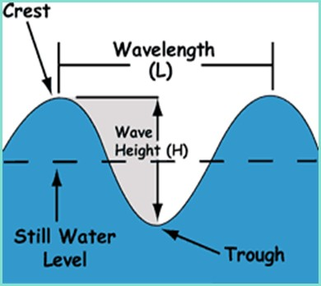
Waves are disturbances that travel through a fluid medium.
Several common wave characteristics include frequency, period, wavelength, and amplitude.
There are two main type of waves, transverse waves and longitudinal waves.

Slide 5
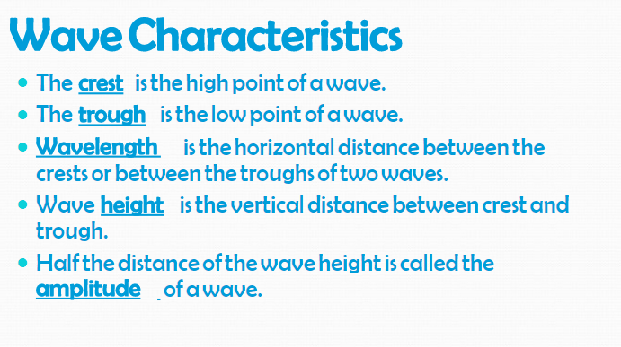

Slide 6
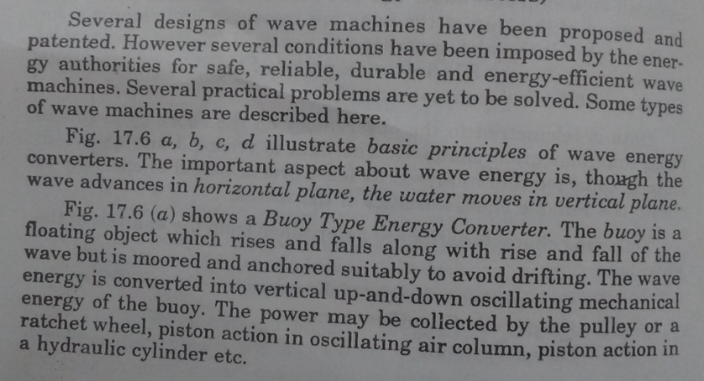
Wave mahines

Slide 7
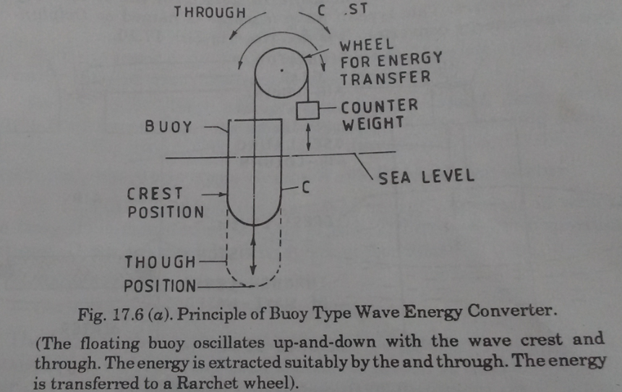
Buoy type wave energy converter

Slide 8
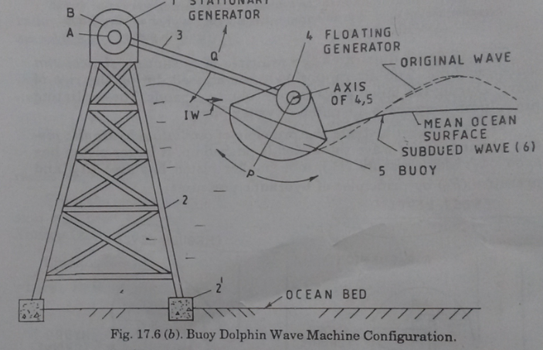
Buoy dolphin wave machine

Slide 9
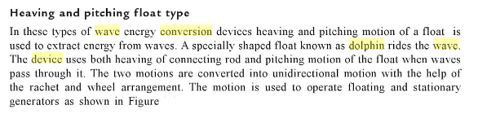
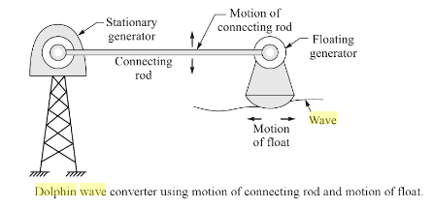

Slide 10
Oscillating Water Columns
Oscillating Water Columns (OWCs) are devices that generate energy from the rise and fall of water caused by waves

Slide 11
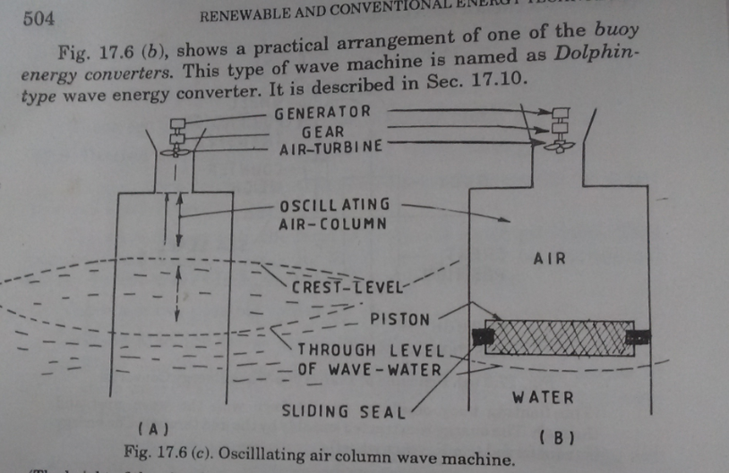
Oscillating air column wave machine

Slide 12
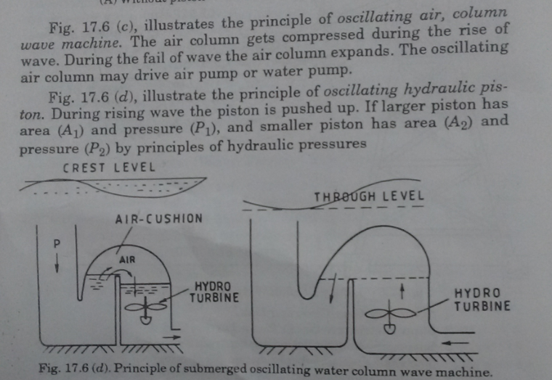
Submerged Oscillating air column wave machine

Slide 13
Salter's duck wave machine
Salter's duck, also known as the nodding duck or by its official name the Edinburgh duck.
It is a device that converts wave power into electricity.
The wave impact induces rotation of gyroscopes located inside a pear-shaped "duck", and an electrical generator converts this rotation into electricity with an overall efficiency of up to 90%.
The Salter's duck was invented by Stephen Salter

Slide 14
The device is designed with a paunch shaped such that the dynamic pressure caused by the wave-induced water particle motions efficiently forces the duck to rotate about its axis of rotation.
The changing in hydrostatic pressure also contributes to the rotation by causing the buoyant fore body near the beak to rise and fall.
Since both of this pressure-induced motion is in phase, the nodding duck can convert not only the kinetic energy but also the potential energy of the wave into mechanical rotational energy.
The rotational motion then is transformed into electricity by a hydraulic-electricity subsystem.

Slide 15
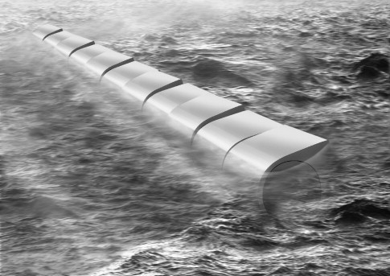
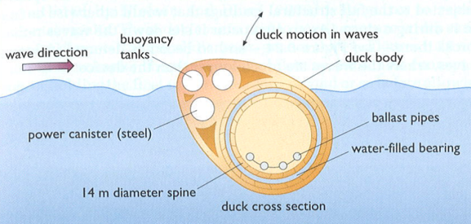
A set of nodding-duck shaped bodies

Slide 16
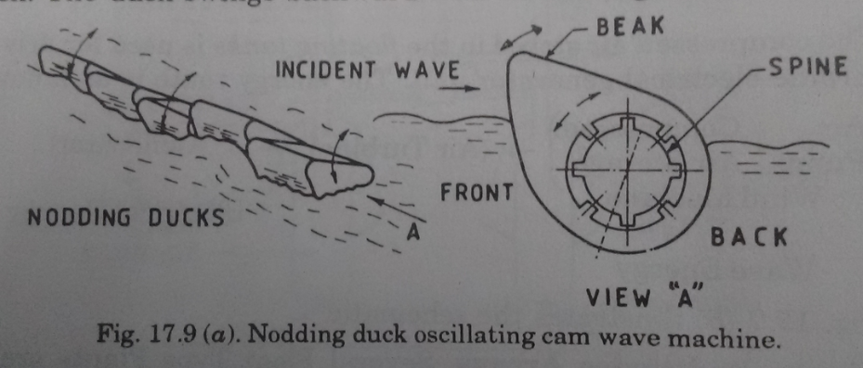
Nodding duck oscillating cam wave machine

Slide 17
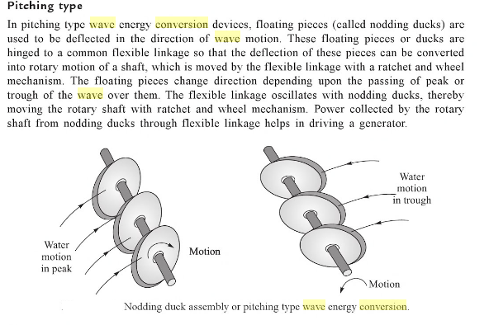

Slide 18
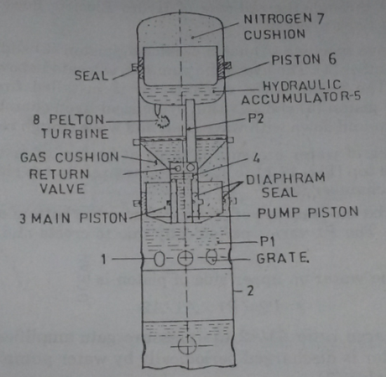

Oscillating hydraulic piston-accumulator wave machine

